Slide 1
WIX1002
Fundamentals of Programming
Chapter 5
Arrays

Slide 2
Contents
Introduction
Multidimensional Arrays
Applications
Bubble Sort
Linear Search
Binary Search

Slide 3
Introduction
An array is a sequence of values of the same type.
It is a data structure that used to process a collection of data that is from the same type.
An array is a group of contiguous memory locations that all have the same name and the same type. It is an ordered list of values and each value has a numeric index (subscript)
An array of size N is indexed from zero to N-1
In Java, an array is a reference data type.
The new operator is used to construct the array.

Slide 4
Introduction
Array Declaration
  typeofArray[] nameOfArray = new typeofArray[length];
  char [] line = new char[100];
  double [] score = new double[20];
When declare an array, each element of the array receives a default value zero for the numeric data type, false for boolean and null for references or String.
Array Initialisation
  int[] number = {1,2,3,4,5,6};
  String[] name = {"one", "two", "three"};

Slide 5
Introduction
A particular value in an array is referenced using the array name followed by the index (subscript) in brackets.
The first element in every array start with 0.
  arrayName[0] refer to the first element
  arrayName[3] refers to the 4th value in the array.
Every array in Java knows its own length.
  arrayName.length - determine the length of the array
  Java will throw an exception if an array index is out of bounds.
Array elements are not limited to primitive data type but also array of object.

Slide 6
Introduction
To display the element of the array
  for(int i=0; i<arrayName.length; i++)
  System.out.println(arrayName[i]);
Or
  for(int value : arrayName)
  System.out.println(value);
  However, this method can’t be used to modify the value of the element of the array.

Slide 7
Update elements of the array
Random r = new Random();
final int MAX=100;
int size = 20;
int[] num = new int[size];
// create an array with random number
for(int i=0; i<num.length; i++) {
num[i] = r.nextInt(MAX+1);
}
for(int i=0; i<num.length; i++) {
System.out.print(num[i] + " ");
}
System.out.println();

Slide 8
Exercise
Create an int num array with a size of 100
  Assign the value of 12 to the first item
  Assign the value of 89 to the last item
Create a char symbol array with the following item
  {'$', '%', '+', '-’}
  Change the ‘+’ item to ‘*’
  Print all of the elements of the array using for loop.

Slide 9
Exercise
Display the number of female student from a random list of 100 students.
  Create an array with 100 students and randomly assign the students gender with male/female.
  Declare a char gender array with ‘M’ and ‘F’.
  Calculate how many female students in the array

Slide 10

Exercise
Given the following
  String str = "Ang,Tan,Fong,Ahmad,Ali";
  Split the string with the following output

Slide 11
Multidimensional Arrays
We can declare arrays with more than one index in Java.
Multidimensional Arrays Declaration
  typeofArray[] … [] nameOfArray = new typeofArray[length_i] … [length_n];
  double [][] scoreTable = new double[4][5];
  //4 rows 5 columns
Multidimensional Arrays with two subscripts are often used to represent tables of values consisting of information arranged in rows and columns.
Multidimensional Arrays Initialisation
  int [][]matrix = { { 1, 2}, { 4, 5} };

Slide 12
Multidimensional Arrays
Ragged Arrays
  Different rows of the array consists of different columns
    int [][]num = new int[3][];
    num[0] = new int[3];
    num[1] = new int[10];
    num[2] = new int[5];

Slide 13
Applications
Summing elements of an array
int a[] = { 1, 2, 3, 4, 5, 6, 7, 8, 9, 10 };
for ( int i = 0; i < a.length; i++ )
total += a[ i ];
Sorting is a technique to arrange elements in same order. Sorting data is one of the common feature that can apply on arrays. The common sorting technique is Bubble Sort.
Searching is a technique to locate an item given its key. Searching locating a particular element value in the array. The common searching techniques are Linear Search and Binary Search.

Slide 14
BubbleSort
The bubble sort uses nested loops to make several passes through the array. Each pass compares successive pairs of elements.
If a pair is in increasing order, the bubble sort leaves the value as they are.
If a pair is in decreasing order, the bubble sort swaps their values in the array.
It requires several pass over the data.

Slide 15
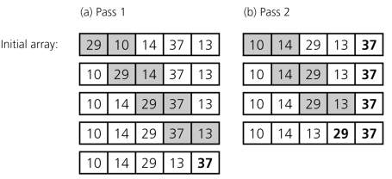
BubbleSort

Slide 16
BubbleSort
// control number of passes
for ( int pass = 1; pass < b.length; pass++ )
// control number of comparison
for ( int i = 0; i < b.length - 1; i++ )
if ( b[ i ] > b[ i + 1 ] ) {
int hold = b[i];
  b[i] = b[i+1];
  b[i+1] = hold;
  }

Slide 17
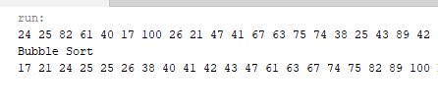
Exercise
Create an array with a size of 20 and assign random number from 0 – 99 in the array
Sort the elements in the array using bubble sort method

Slide 18
Linear Search
This method works well for small arrays or for unsorted arrays.
The search technique search the array from the first position to the last position in a linear progression.
It compares each element of the array with a search key.
    for ( int cnt = 0; cnt < arrayName.length; cnt++ )
    if ( arrayName[ cnt ] == searchKey )
    return cnt;
    return -1; // key not found

Slide 19
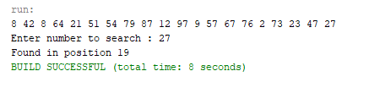
Exercise
Create an array with a size of 20 and assign random number from 0 – 99 in the array
Prompt the user to ‘enter number to search’
Use linear search method to find the position

Slide 20
Binary Search
This method works well for large and sorted arrays.
It eliminates half of the elements in the array being searched after each comparison.
It locates the middle array element and compares it to the search key. If the search key not found, the binary search reduces the problem to search for half of the array.
int low = 0; // low element subscript
int high = arrayName.length - 1; // high element subscript
int middle; // middle element subscript

Slide 21
Binary Search
// loop until low subscript is greater than high subscript
while ( low <= high ) {
middle = ( low + high ) / 2;
if ( key == arrayName[ middle ] )
return middle;
else if ( key < arrayName[ middle ] )
high = middle - 1;
else
low = middle + 1;
}
return -1; // key not found

Slide 22
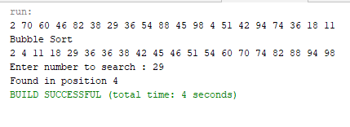
Exercise
Create an array with a size of 20 and assign random number from 0 – 99 in the array
Prompt the user to ‘enter number to search’
Use binary search method to find the position
  Note: the array need to be ascending order.

Slide 23


